Slide 1
AIR QUALITY INDEX MONITORING SYSTEM
S.MUSHKIN ALI-RA1911026010108
S.SANKARSH-RA1911026010110

Slide 2
INTRODUCTION
The main objective of our project is to let the people know the quantity of harmful gases which are surrounded.
We human beings are unable to distinguish the harmful gases which are present in the air with our naked eye.
This device mainly focus to remove all these issues and it would be very helpful to us.
This device Air quality monitoring system provides us clear information regarding the gases quantity and also notifies us if the limit is exceeded.

Slide 3
WORKING OF MODEL
The model displays the main components required:
Home Gateway
CO detector
Windows
Siren
Humidity Monitor
Temperature Monitor
Smartphone

Slide 4
Firstly we should connect all the IOT devices to the Home gateway.
Next Connect the smartphone to the Home Gateway.
Connect to the Home gateway through the IP address of the Home Gateway.
Add the conditions for which we should get the indication
Check the end results.

Slide 5
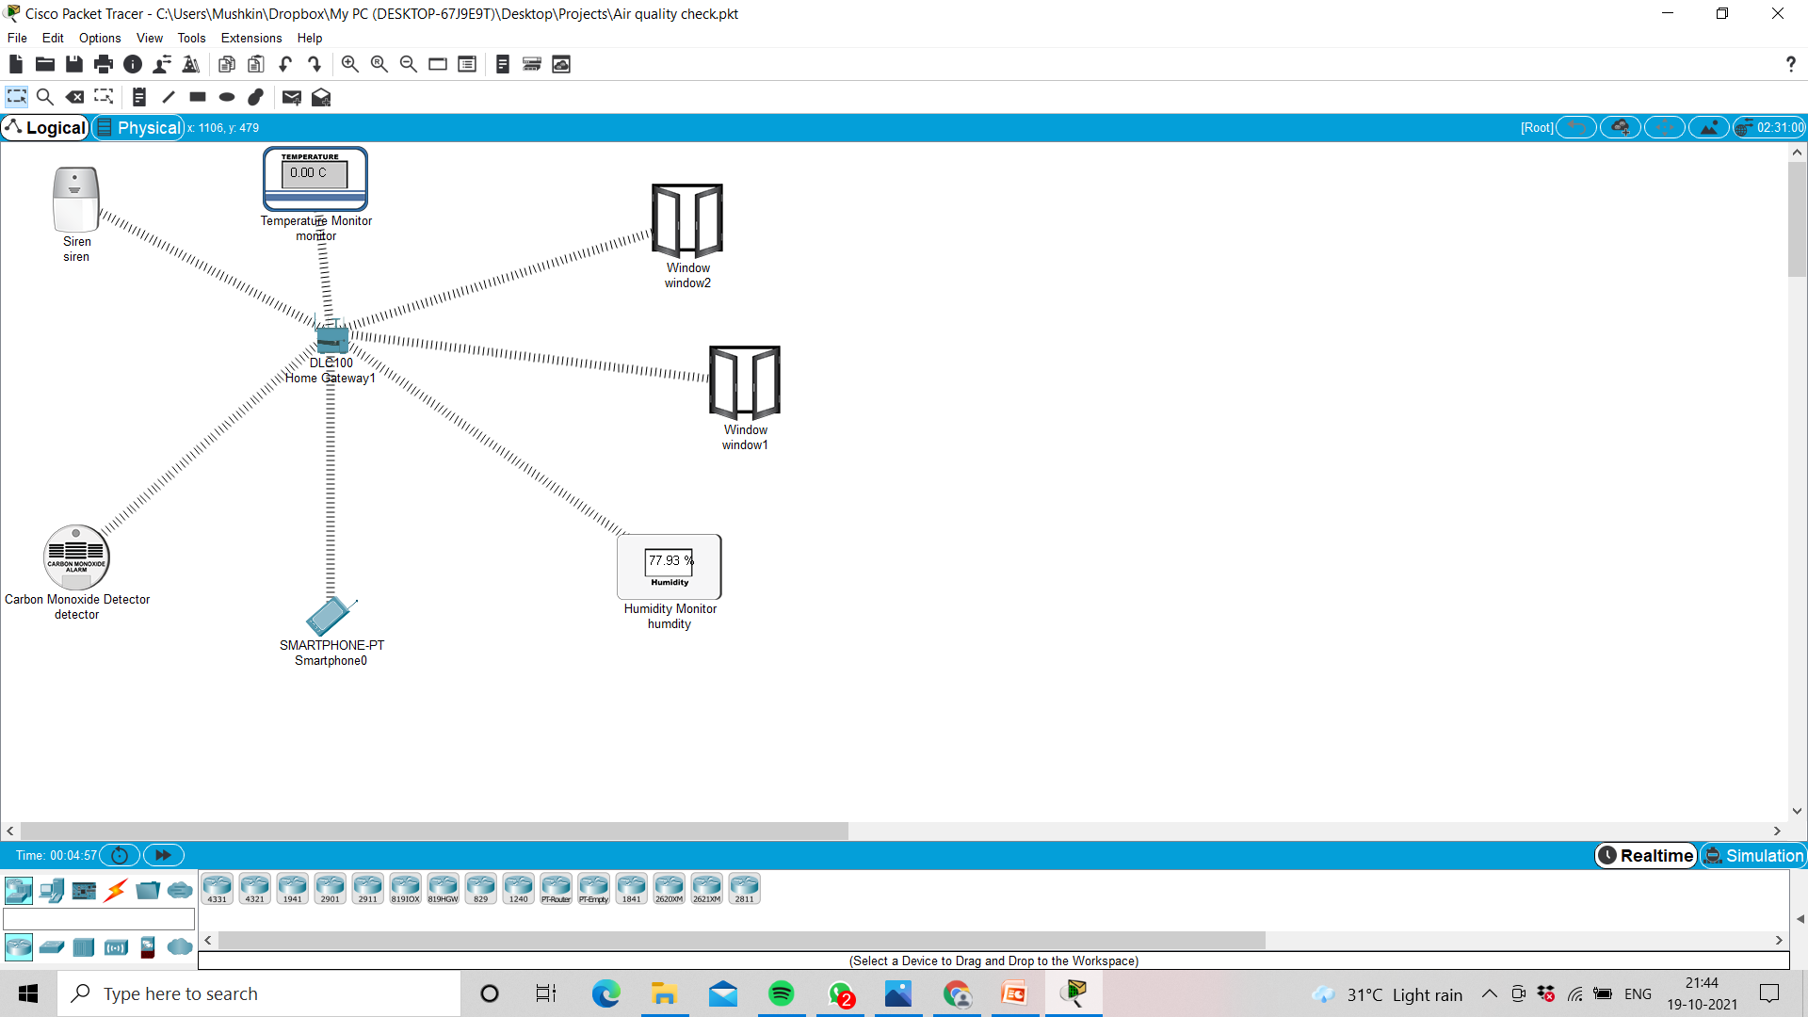

Slide 6
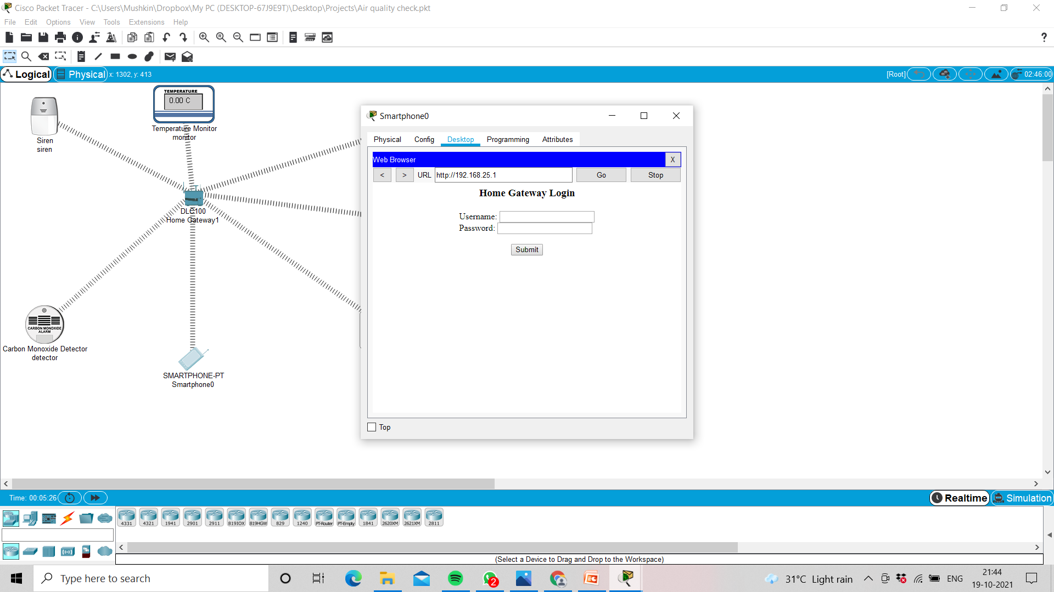
ADMIN LOGIN

Slide 7
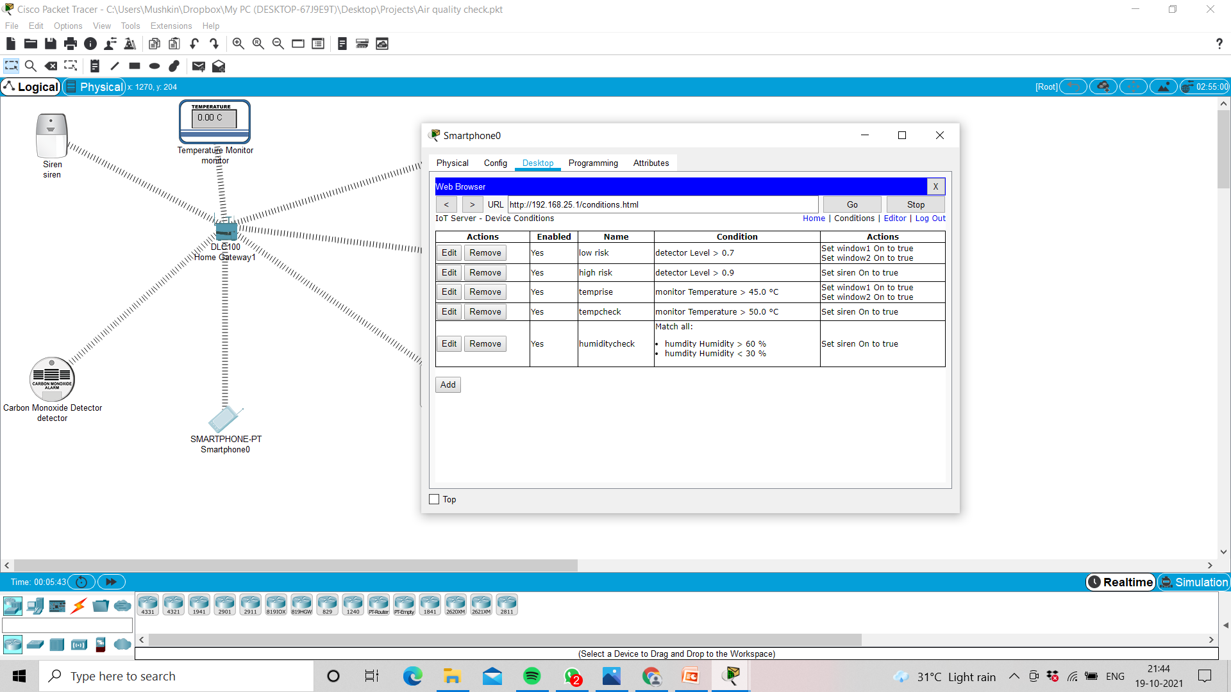
Providing Conditions

Slide 8
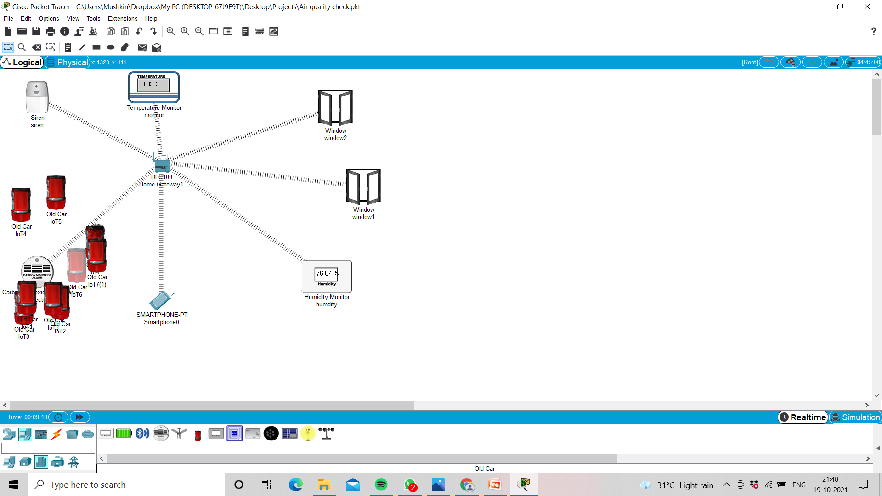
Checking The Model

Slide 9
THANKYOU

